Slide 1
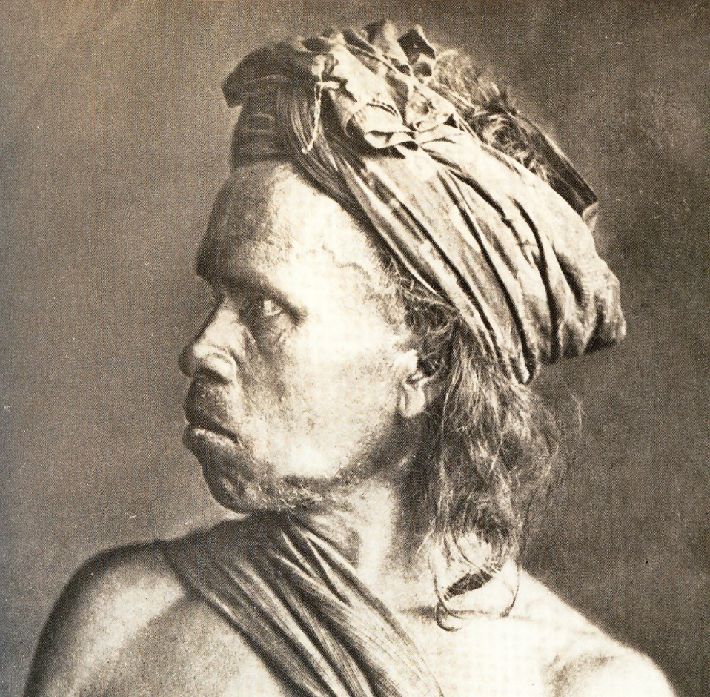
Introduction to Anthropology
Batak Tribesman –c. 1880
© Jennifer L. Anderson 2014

Slide 2
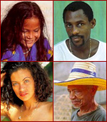
Anthropology literally means the “science of mankind.”
Notes:
But it is only one of the sciences of man. There are many other social sciences such as sociology, psychology, political science, and economics. What distinguishes anthropology from the other social sciences is its holistic approach. Anthropologists try to understand the interaction between a variety of systems and processes that influence human behavior.

Slide 3
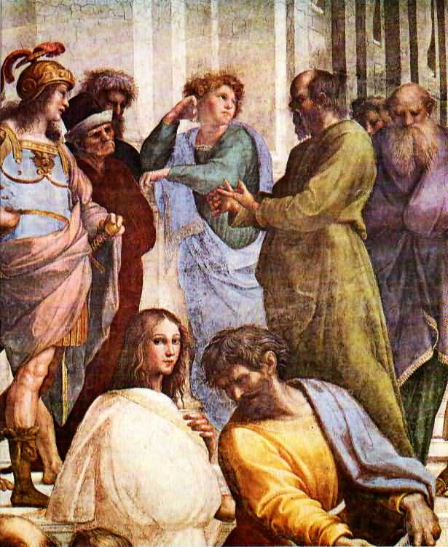
The social or behavioral sciences grew out of inquiries about the nature of humanity which date back to Greek and Roman times.
Socrates
Notes:
Of course, great thinkers in non-western traditions were conducting equally valid and interesting inquiries. But, the social sciences, as we study them today, were really products of the Age of Enlightenment.

Slide 4
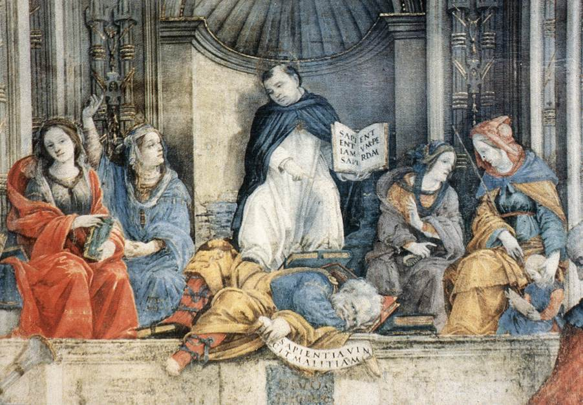
Triumph of St Thomas Aquinas over the Heretics (detail) (1489-91) Fresco
S. Maria sopra Minerva, Rome
Notes:
During the Dark Ages of Medieval Europe, few dared suggest alternatives to the beliefs which supported social institutions sanctioned by Church and State.
Here SaintThomas Aquinas is surrounded by four female figures representing the orthodox study of Philosophy, Astronomy, Theology, and Latin Grammar. You can see what happened to heretics.

Slide 5
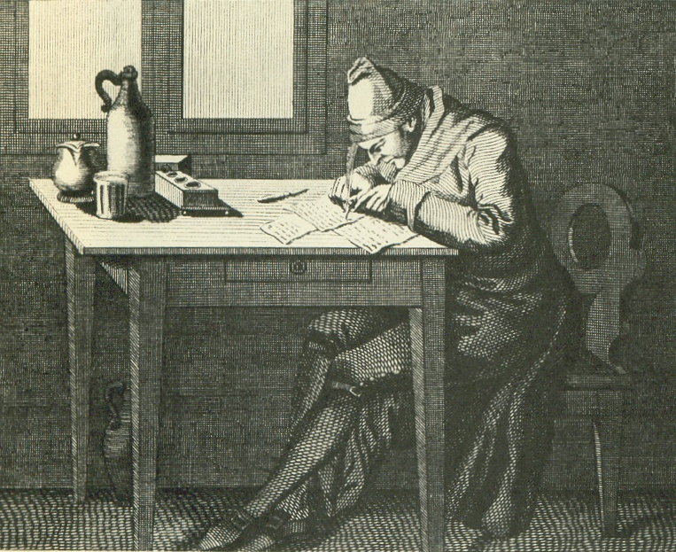
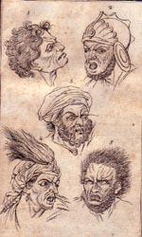
The idea that human society was an appropriate scientific area of study began to develop in seventeenth century Europe.
Physiognomist John Lavater
Notes:
Not all of the ideas scholars came up with during this era were good or progressive. Physiognomists like John Lavater believed that personality could be determined by facial characteristics. Not only were his ideas a dead-end scientifically, but they were used to justify racism.

Slide 6
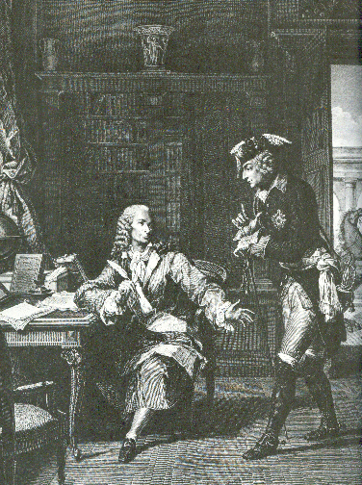
For the most part, however, the Age of Enlightenment meant that intellectuals were free, within limits, to talk and think about what was good and bad in their societies and in others.
Voltaire and King Fredrick II of Prussia
Notes:
This new freedom was coupled with a growing awareness of the huge variety of human experience. This was the result of dramatic improvements in communications and transportation.

Slide 7
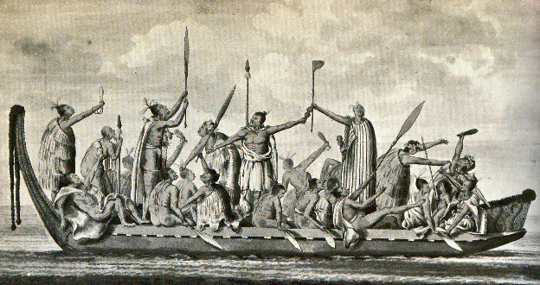
Maoris - 1769
Notes:
The expansionist ambitions of European states, which were directed toward the acquisition of colonies, also brought western thinkers into more frequent contact with people whose mere existence challenged their assumptions about the world and man’s place in it.

Slide 8
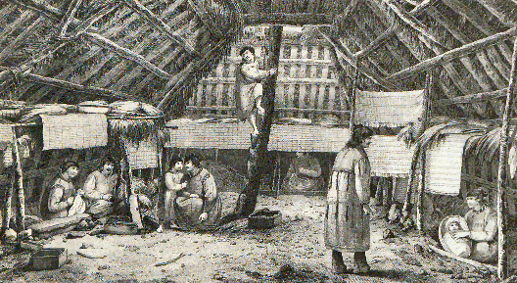
Aleutian Islands -1778- Voyage of Captain Cook
Notes:
Confronted by the realization that prevailing Judeo-Christian philosophy might be insufficient to explain the diversity in human behavior, European philosophers began to develop concepts of socio-political structures which would eventually result in the idea of a linear trend in the development of civilization. These thinkers were particularly interested in the question of what is ‘natural” to human beings and what could be imposed by society.

Slide 9
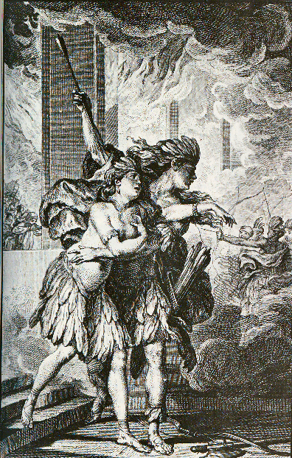
One of the most influential ideas of the era was the concept of the “Noble Savage.”
Incas of Peru from 1777 print
Notes:
One of the great philosophical debates of the period centered around the question of whether development in the arts and sciences had improved man’s moral character. The French philosopher Rousseau believed that people were good and innocent by nature and that civilization had a corrupting influence on mankind.

Slide 10
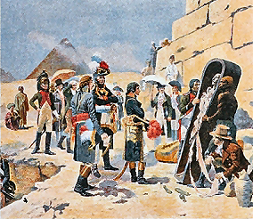
Anthropology began to develop a distinct character as a discipline in its own right in the early nineteenth century.
Napoleon in Egypt
Notes:
In 1800, a group of French medical men and naturalists founded a group called “The Society of the Observers of Man.” They were particularly interested promoting the study of human behavior among travelers, explorers, and colonial administrators.

Slide 11
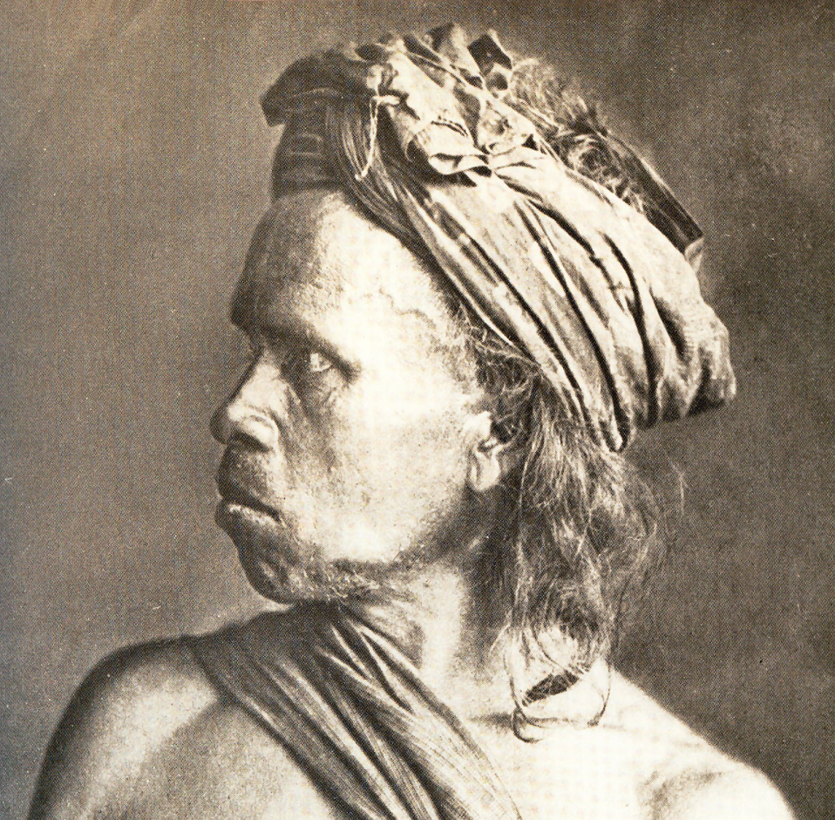
Because colonialists often kept detailed diaries and wrote long letters, they became the earliest ethnographers.
Batak Tribesman –c. 1880
Notes:
Ethnography is best defined as detailed reporting on the manners and customs of geographically dispersed human groups, In 1820, Sir Thomas Raffles, the British Governor of Java, wrote: “The Bataks are not a bad people, and I still think so, not withstanding they eat one another, and relish the flesh of a man better than that of a pig. You must merely consider that I am giving you an account of a novel state of society. The Bataks are not savages, for they write and read, and think full as much, and more than those who are brought up at our Lancastrian and National Schools.” His comments exemplify the conflict in his times between the ideal of the noble savage and preconceptions about “civilized” behavior.

Slide 12
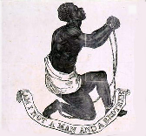
In 1838, a society with both intellectual interests and a social agenda similar to the “Society of the Observers of Man” was formed in London.
Notes:
It was called the “Society for the Protection of Aborigines”. This group more concerned about political and social issues than scientific ones because the abolition of slavery was becoming a topic of great concern in England. These developments were noted on the other side of the channel but, because of conservatism associated with the recent restoration of the French monarchy, it was not possible for the French to form such a blatantly liberal political association. Instead, in 1839 a group of French scientists established the “Ethnological Society of Paris”.

Slide 13
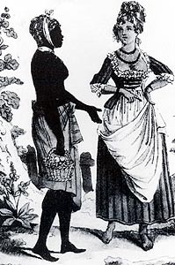
Their first order of business was an attempt to compare the distinctive characteristics of black and white people.
Women in West Indies
Notes:
They wanted to know if there was a scientific basis for the contemporary belief that white people were intellectually superior to black people because this idea was used as a justification for slavery.

Slide 14
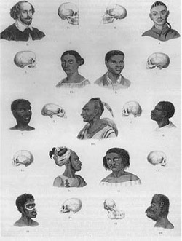
1850 plate on “race” and skull type
Notes:
This plate from 1850 suggests a “scientific” evolutionary hierarchy based on skull type. (From White on Black by Jan Nederveen Pieterse, New Haven and London: Yale University Press 1992, pg 48.)

Slide 15
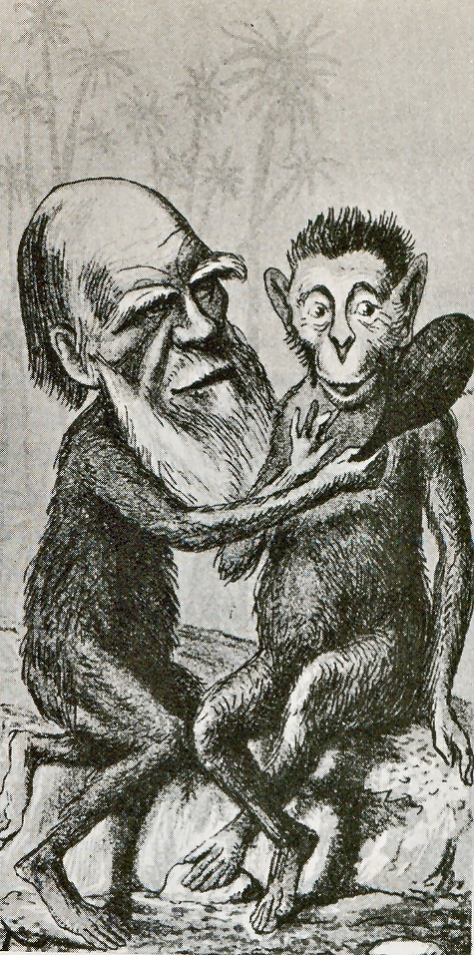
Darwin’s research on natural selection provided an opportunity to separate and clarify concepts of physical and social evolution.
1874 Print – London Sketchbook
Notes:
Even though he did not discuss human evolution until ten years after the publication of the Origin of Species in 1859 and his theories were seriously misunderstood, Darwin’s research enflamed the debate on what it meant to be human. After all, if the behavior of other species “evolved,” why not that of human beings?

Slide 16
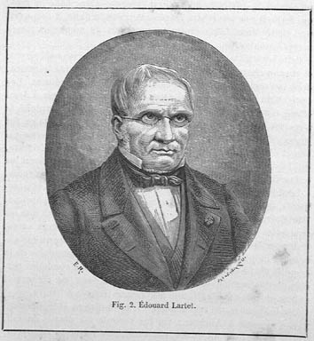
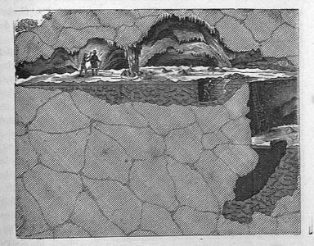
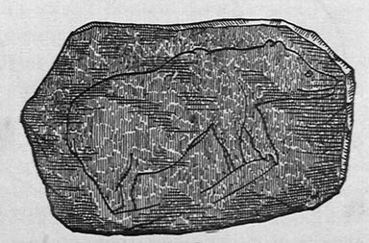
Edouard Lartet
Illustrations from L’HOMME PRIMITIF
By LOUIS FIGUIER published in 1876
Notes:
Antiquarians began scouring both the New and Old World for relics of lost civilizations which could be used to refute Darwin and document prevailing theories of social development based on Biblical history. In 1855, a road mender at work near Aurignac in the French Pyrenees found a cave with seventeen human skeletons, stone and bone tools, and the remains of extinct animals. The skeletons were promptly given a proper Christian burial. Eight years later, a local magistrate named Edouard Lartet published a paper based on what he had seen in the caves. It was becoming increasingly clear that early Europeans had lived at the same time as extinct animals.
The idea that people from so-called primitive societies were somehow less physically or socially developed had long influenced western thought. Now Europeans had to face the fact that they too had evolved.

Slide 17
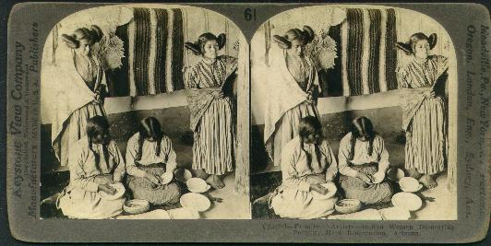
Feverish enthusiasm for the new concept of biological evolution led to its wholesale application to social arenas.
Stereo-print of “Primitive Artist Indian Women”
Notes:
This was not appropriate. The concept of parallel social and physical evolutionary trends in human development allowed Euro-centric thinkers to assign a lower place on the scale of human development to people who did not fit their model for “modern” man. Since many of the human groups Europeans were encountering in their colonial adventures were not Caucasian, the concept of Darwinian evolution could be twisted by racists to imply that people whose life-style did not fit the European mold were members of “lower orders” or primitives. They were seen as living fossils.

Slide 18
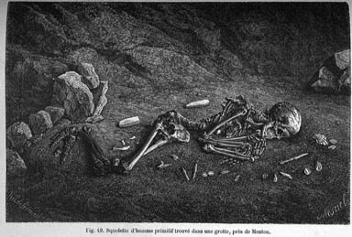
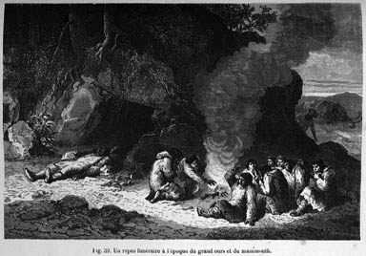
Illustrations from L’HOMME PRIMITIF
By LOUIS FIGUIER published in 1876
Notes:
About this time, the study of man began to diverge into physical and cultural anthropology.

Slide 19
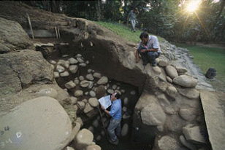
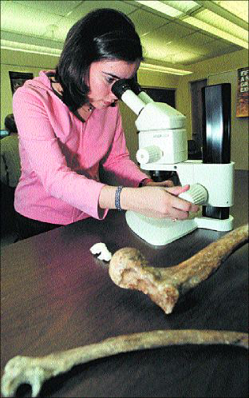
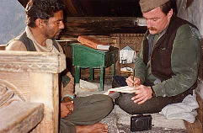
Archaeologists
Physical Anthropologist
Cultural Anthropologist/Sociolinguist
Notes:
Some anthropologists became interested in the physical side of man’s evolution and began using archaeological data as the basis of their inquiries. Other anthropologists were more interested in the diversity of behavior in living peoples.

Slide 20
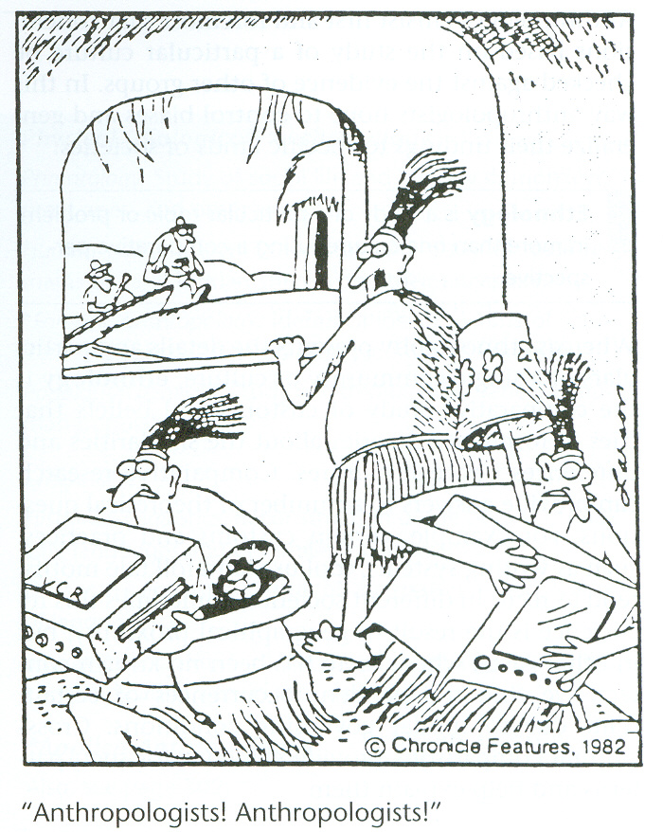
The Four Fields of Anthropology
Physical Anthropology
Archaeology
Anthropological Linguistics
Cultural Anthropology
Notes:
Today, anthropology is divided into four major fields.

Slide 21
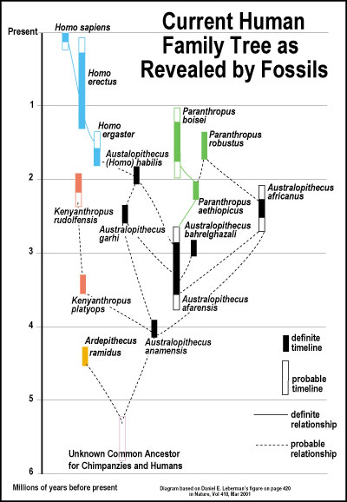
Physical Anthropology
Paleoanthropology
Biological Anthropology
Notes:
Paleoanthropologists are concerned with the study of human evolution through fossil remains. Primatologists study non-human primates in their natural environments with the aim of gaining insight into human evolution. Biological anthropologists study both human evolution and contemporary physical variations among the world's people. Our understanding of human evolution is being considerably enhanced through the study of population genetics, the study of inherited physical traits. Some biological anthropologists also study the interrelationship between human populations and their environments. Epidemiologists contribute to the anthropological dialogue by investigating the transmission of disease among human populations. Other kinds of medical anthropologists study the relationship between biology and sociocultural factors related to health and disease. They may study the culture of medical institutions and health care providers or specialize in nutrition. Nutritional anthropologists believe understanding the relationship between the human diet and culture can provide us with insights into health and behavior.

Slide 22
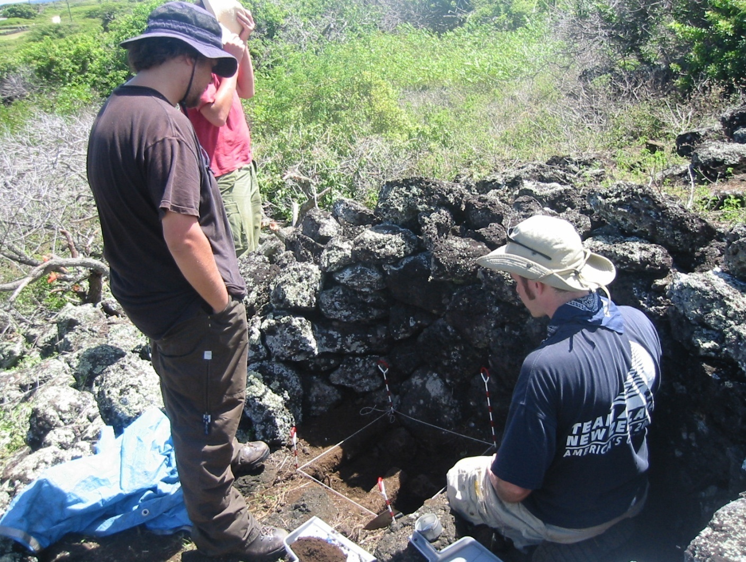
Archaeology
Archaeologists working in Hawaii uncover a stone lined hearth (left to right, Jonathan Carpenter, Calum Wilkenson (back), and Mark McCoy).
Notes:
Archaeologists study people of the past by excavating and analyzing material remains. They look not only at human remains but the artifacts people leave behind. They can derive a surprising amount of information from such things as the location of the postholes in ancient dwellings or even the pollen found in levels of soil associated with other artifacts. Cultural resource management is the area of archaeology that deals with ensuring the preservation of archeological sites. Sometimes an archeological site is impacted by proposed construction. An archeologist may be called upon to determine the significance of the site and help devise a plan to protect it. If the damage is unavoidable, the archeologist may excavate to get as much information from the area as possible before it is destroyed. Cultural resource managers are also often called upon to monitor construction to make sure that nothing of cultural significance is inadvertently damaged. Due to the proliferation of protection laws at both the state and federal level, cultural resource management has become a growth industry. Today, about half of all archeologists work in this area.

Slide 23

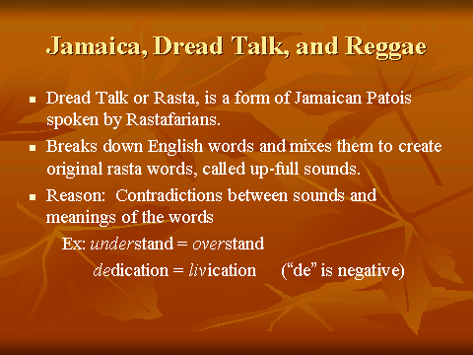
Anthropological Linguistics
Notes:
Sociolinguists can learn a lot about human behavior by studying how people use language. They look at how languages change over time, how languages separate and combine, and investigate the relationship between language and culture. If you want to do a little sociolinguistic investigation of your own, listen to your fellow students when they get together on campus. Some will practice code-switching, that is, they will combine two languages such as Spanish and English in one conversation. A code-switcher must be skilled in the grammar and vocabulary of two languages. It says a lot about the cultural environment in which they grew up.

Slide 24
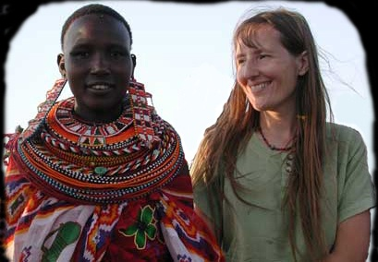
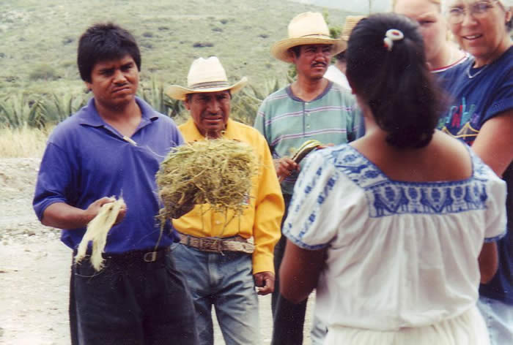
Cultural Anthropology
Notes:
A sociolinguist is one kind of cultural anthropologist. Cultural anthropologists look at the intersections of a variety of cultural systems such as law, religion, kinship, political structures, etc. in order to understand other people. Some write ethnographies describing cultures in which they live. Others are ethnologists who compare cultures on the basis of information they and others have collected. They may work in traditional cultures around the world or in the world's growing urban areas.

Slide 25
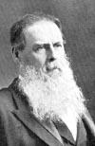
Edward Tylor 1832-1917
The concept of “culture” became central to the development of theory among social anthropologists and ethnographers.
Notes:
In 1871, Edward Tylor introduced the classic definition of “culture” in the first paragraph of his influential work, Primitive Culture. He said:

Slide 26
Culture . . . is that complex whole which includes knowledge, belief, art, morals, law, custom, and any other capabilities and habits acquired by man as a member of society.
Notes:
More than any other idea, it is the concept of culture that identifies and drives the work of cultural anthropologists.

Slide 27
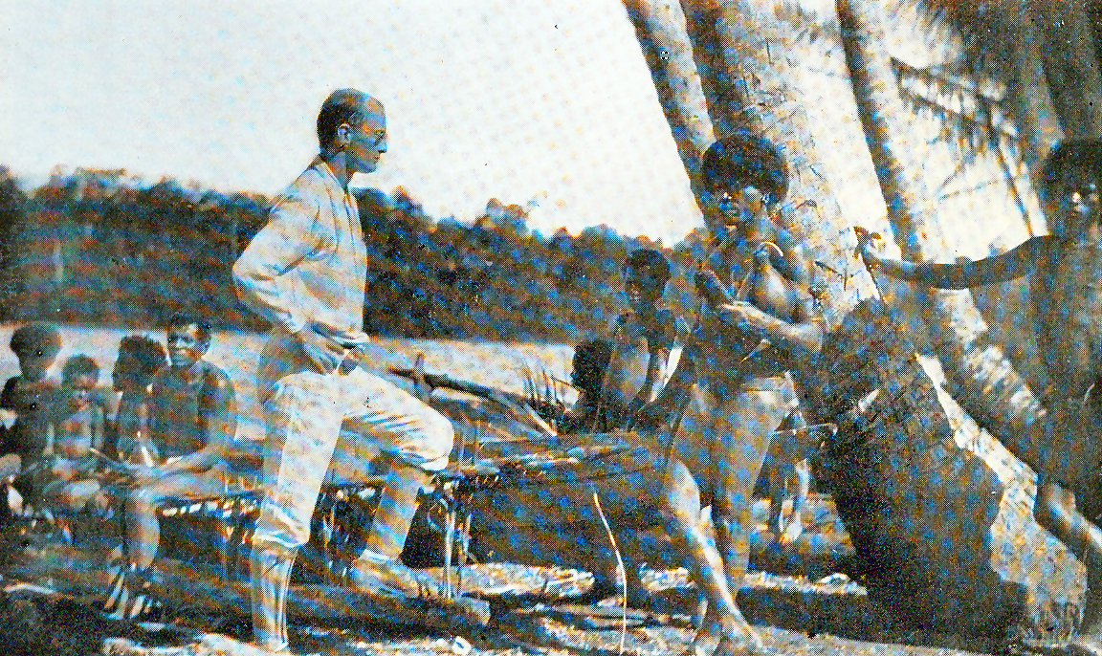
Bronislaw Malinowski interviewing Trobriand sorcerer c. 1917
Notes:
What distinguishes anthropologists from other social scientists interested in virtually the same subject matter is anthropologists’emphasis on field work and participant observation. Anthropologists live among their subjects. They conduct interviews with informants, keep detailed field notes, and analyze behavior. By systematically collecting information on the kinds of people engaged in particular behaviors at certain times, anthropologists try to detect patterns of behaviors. The comparative study of the patterns of various groups is called ethnology.
Bronisław Kasper Malinowski was a Polish anthropologist widely considered to be one of the most important anthropologists of the twentieth century because of his pioneering research on ethnographic fieldwork, the study of reciprocity and his detailed contribution to the study of Melanesia

Slide 28
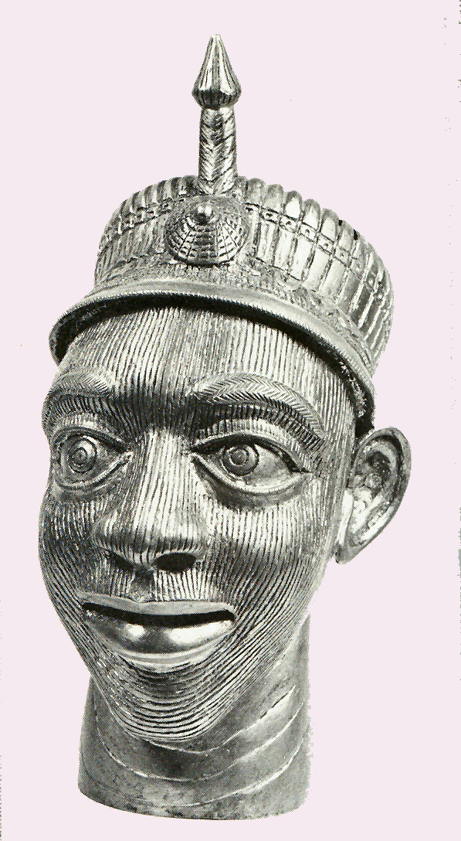
As time went on anthropologists became more curious about the way certain cultural materials and traits passed from group to group.
Copy of an Ife (Nigerian) bronze head wearing a western military helmet by an artist from Cameroun
Notes:
The people they studied were changing. Diffusion and adaptation became central areas of concern. Anthropologists began to realize that behavioral traits are best understood when they are viewed within the cultural context or contexts in which they function. This is called cultural relativism. Cultural relativism is a reaction to ethnocentrism. Ethnocentrism is the practice of interpreting the customs of other human groups from the viewpoint of one’s own. It is not possible to totally avoid ethnocentrism since our cultural programming is complex and subtle. But, what we can do is to try to avoid making judgmental comparisons of the cultural practices of others without trying to understand their original cultural milieu. When a cultural trait is viewed from the perspective of a cultural insider it is called the emic view. An outsider sees the same phenomenon from the etic perspective.

Slide 29
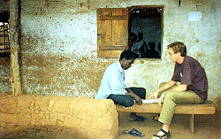
Today, most anthropologists try to integrate a humanistic approach to anthropology with scientific techniques.
Notes:
The humanistic approach emphasizes describing the rich variety of human experience through the collection of life histories, personal stories, and through the investigation of the meaning certain behaviors have for the people that engage in them. The scientific method uses the “compare and contrast” approach and the method of hypothesis testing. Unfortunately, the strict use of the scientific method is often confounded by the sheer variety of human experience. We can only predict probable behavior, people often behave unpredictably. A famous anthropologist, Alfred Gell, said that: Anthropology is, to put it bluntly, considered good at providing close-grained analyses of apparently irrational behaviour, performances, utterances, etc. . . The aim of anthropological theory is to make sense of behaviour in the context of social relations.” And, that is what we will do in this class.

